Slide 1

CPEN 333 Final Project
Bobby smith, David chung, Mathew pither, nick vo

Slide 2
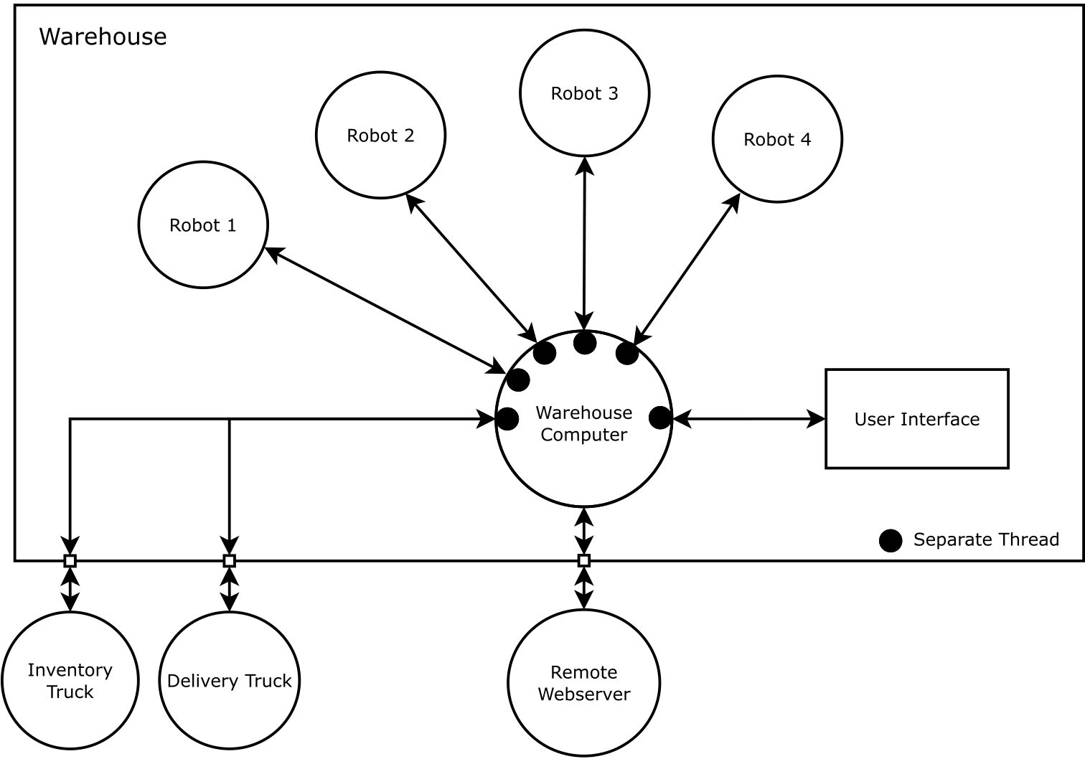
Purpose
Create an automated system
The central warehouse computer
The user-interface for the computer
The automation robots
The remote webserver
Delivery and restocking trucks

Slide 3
central warehouse computer
Main Control System
Keep track of inventory
Warehouse
Order from server
Trucks
Robots

Slide 4
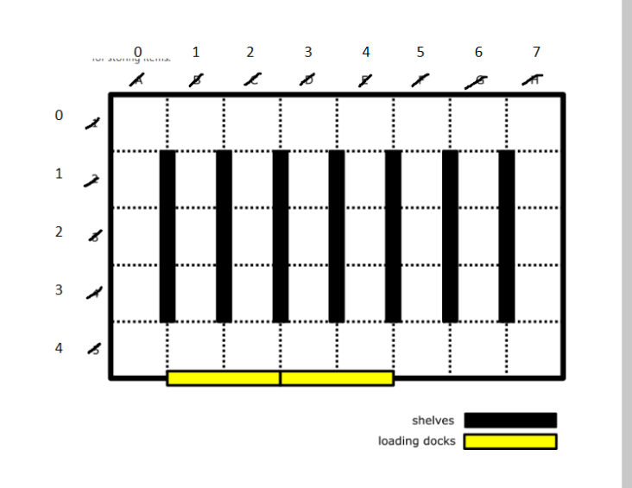
robot
Warehouse structured into array
Robot moves clockwise

Slide 5
Delivery and restocking trucks
Docks are given tasks
Items in truck is listed in queue

Slide 6
Testing plan
A robot movement with given value
Unit test for functions

Slide 7
Testing demo

Slide 8
Main struggle
Creating a collision avoidance strategy
API server and website structure
Defining docks for truck
Learning new framework and languages

Slide 9

Questions

